Slide 1
Effects of COVID in New Zealand
By
Track Stars
(Zahid Khan, Perry li,
Jiani Wu, Kaishun Yang)
Notes:
Hello everyone, We are team TRACK STARS, and we decided to analyse the Effects of Covid in New Zealand.

Slide 2
Topics and Contents Covered
Total number of COVID Cases
Vaccines Administered
Crime Rate
Deathrate
Agriculture
GDP (Gross domestic product)
Notes:
As we all know that COVID has had a huge impact on almost every sector of our economy as well as our lives.
We do not have enough time or resources to cover each sector, so we choose 4 topics, which are :
Effects of COVID on CRIME RATE
Effects of Vaccination on DEATH RATE
Effects of COVID in Agriculture sector
And
Effects of COVID on NZ GDP

Slide 3


Data Sources
Covid Data
Ministry of Health NZ (Git Repo)
https://github.com/minhealthnz/nz-covid-data
Vaccination Data
Ministry of Health NZ (Git Repo)
https://github.com/minhealthnz/nz-covid-data
Crime Rate
New Zealand Police statistics
https://www.police.govt.nz/about-us/publications-statistics/data-and-statistics?nondesktop
Death Rate
Ministry of Health NZ (Git Repo)
https://github.com/minhealthnz/nz-covid-data
Notes:
The data collected for Covid Cases, Death rate and Vaccination is from Ministry of health Git-Repository.
Crime Rate statistics were collected from the NZ police website Which was another challenge.

Slide 4

Data Sources
Agriculture
Before Covid:
https://www.stats.govt.nz/information-releases/agricultural-production-statistics-june-2019-final/?fbclid=IwAR2WAR9QR33HcLXF7Nt-JAZZRukfgQiDJhFAukYjOz_HKqKOeQ8kJzxky3c
After Covid:
https://www.stats.govt.nz/information-releases/agricultural-production-statistics-year-to-june-2021-final/?fbclid=IwAR04a29AGmveWZyfI0V9i9yD-5OP68RAazrGrpmOWMw4GRZKpane8jcWjzA
GDP
https://www.stats.govt.nz/information-releases/gross-domestic-product-june-2022-quarter/?fbclid=IwAR1bfYeCwfOSBIp97SkhGlWFzReIxGYD5Q7Fl5jaCmCf3yLqgXgGKbgwjIw
Notes:
For Agriculture and GDP sector the data was collected from Stats NZ

Slide 5
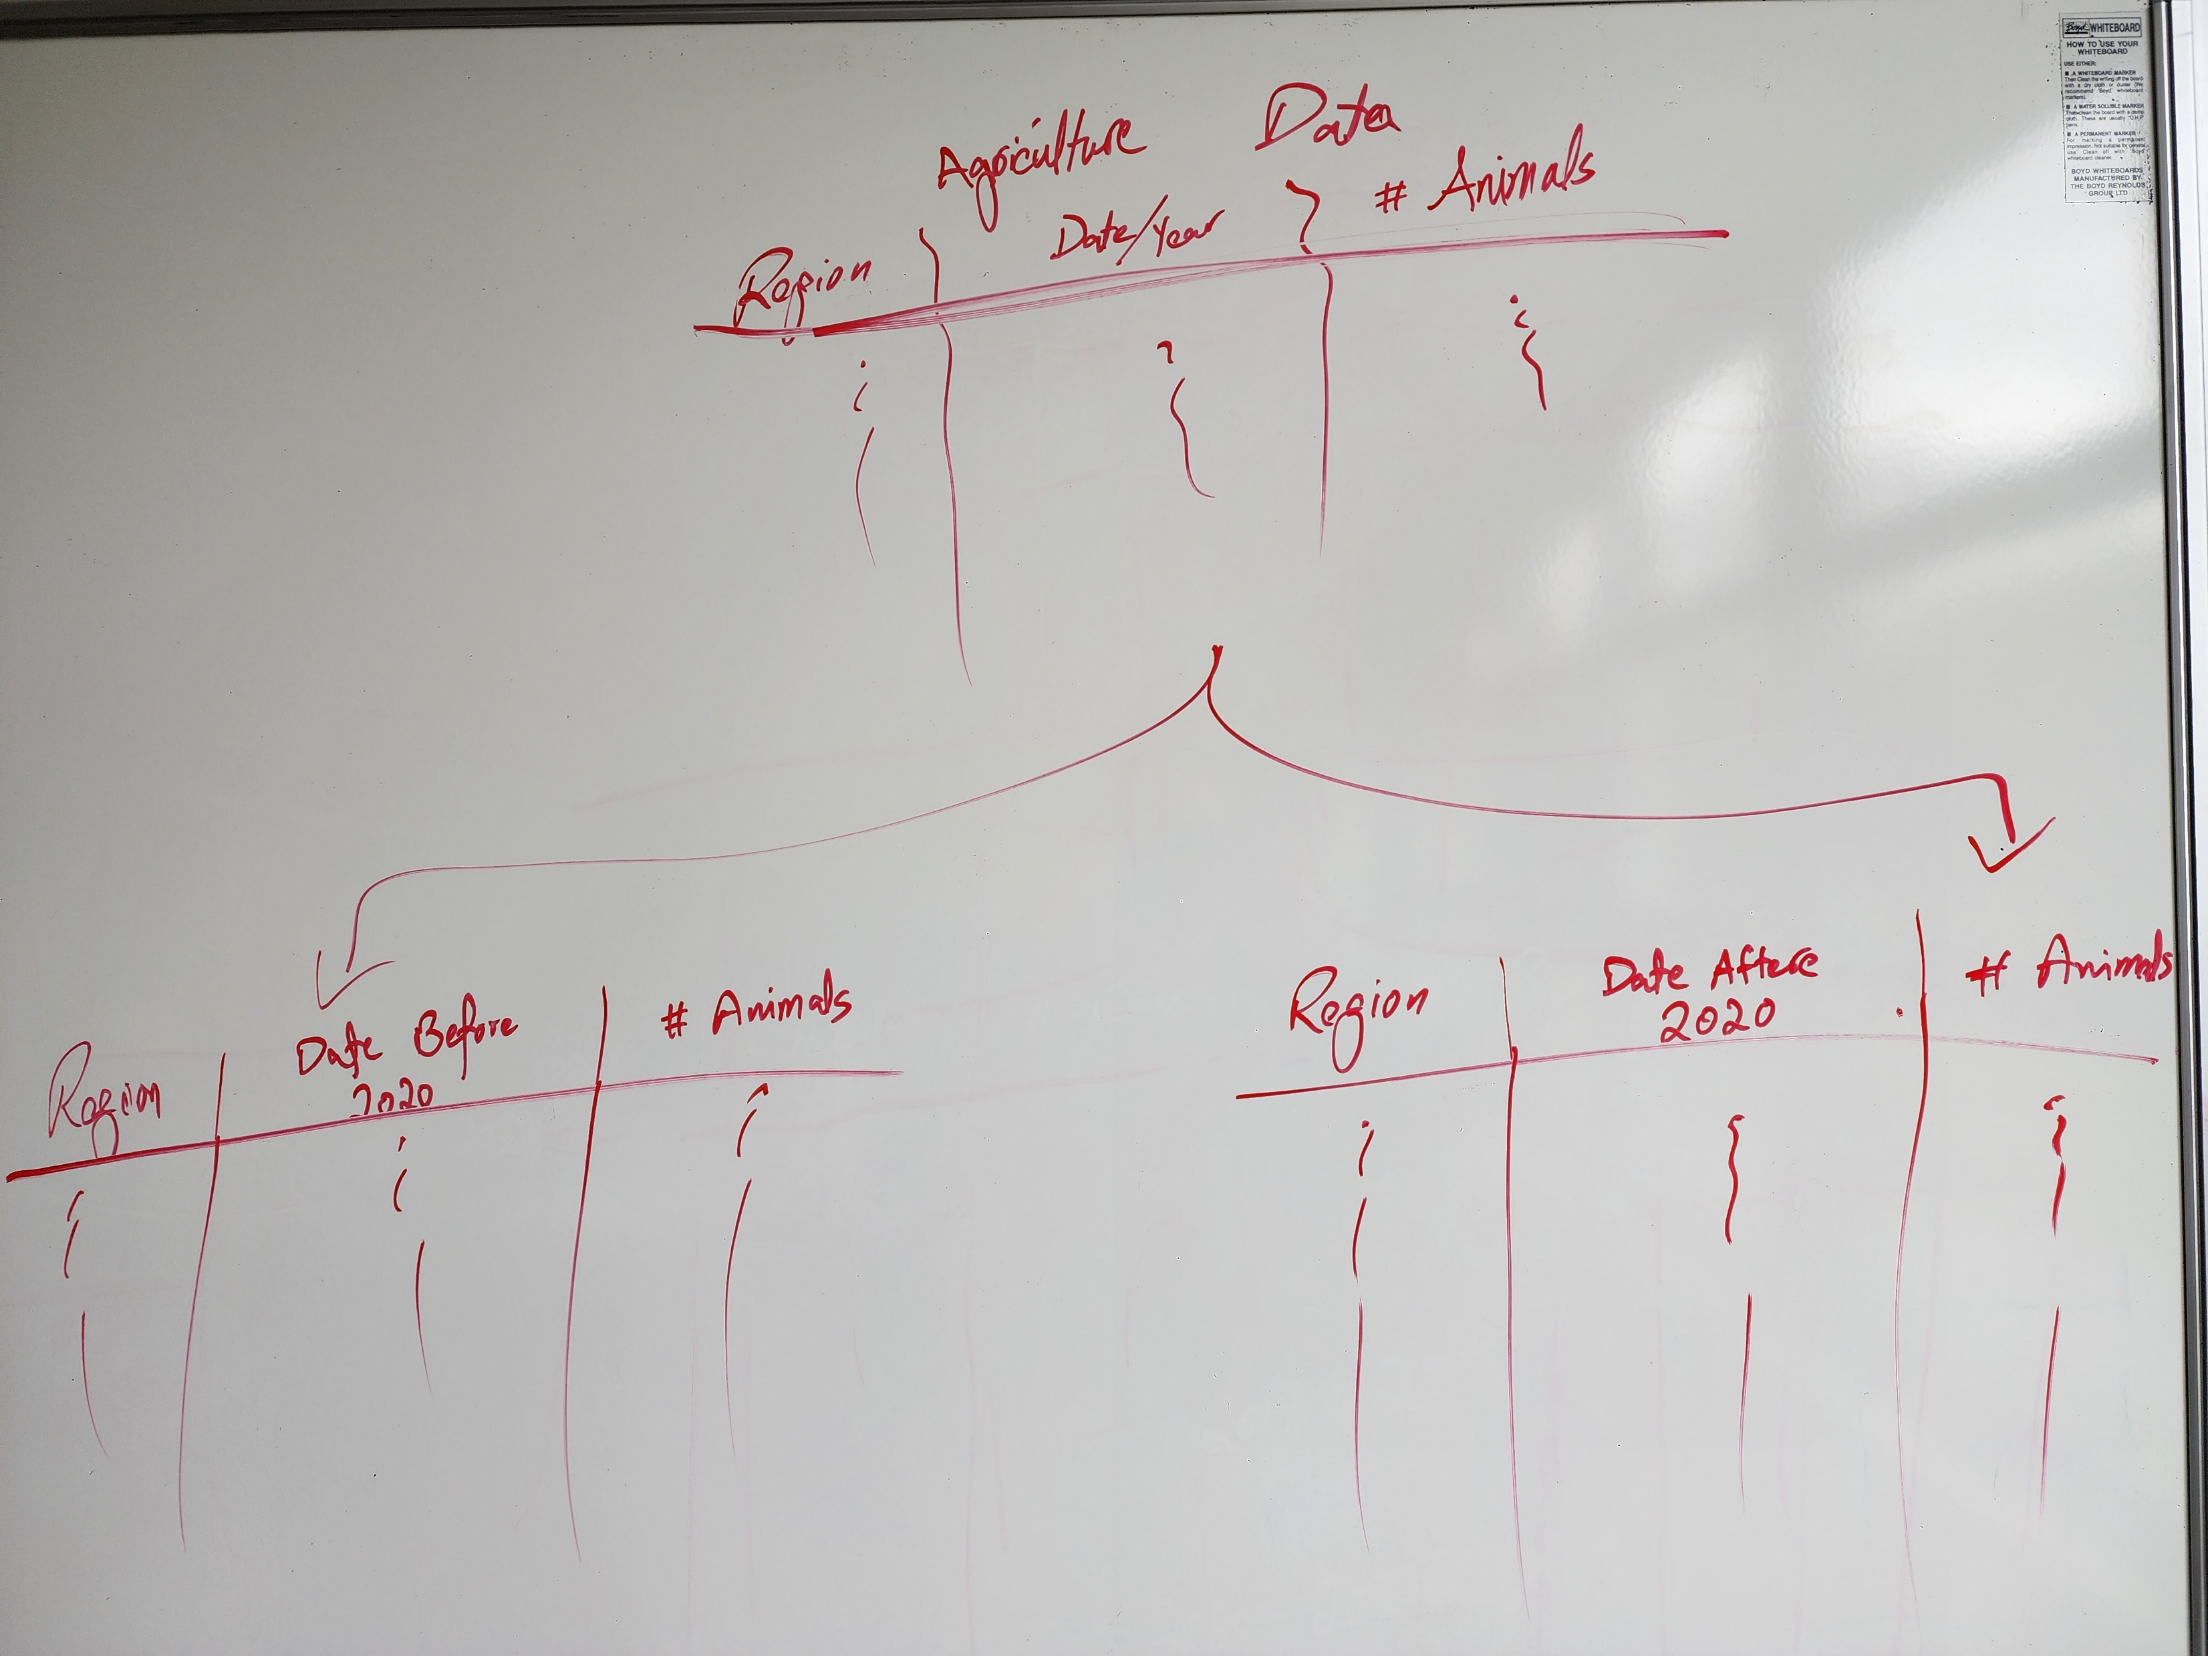
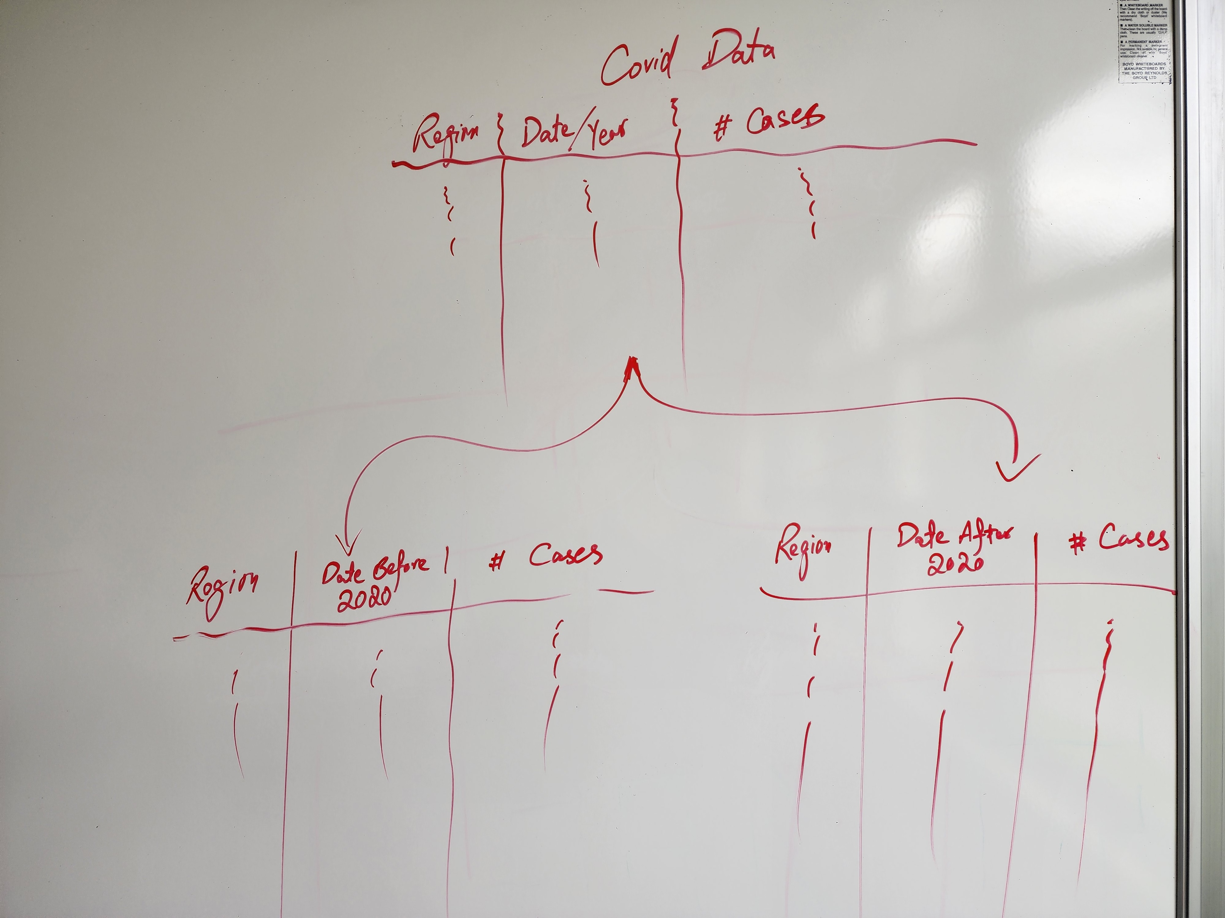
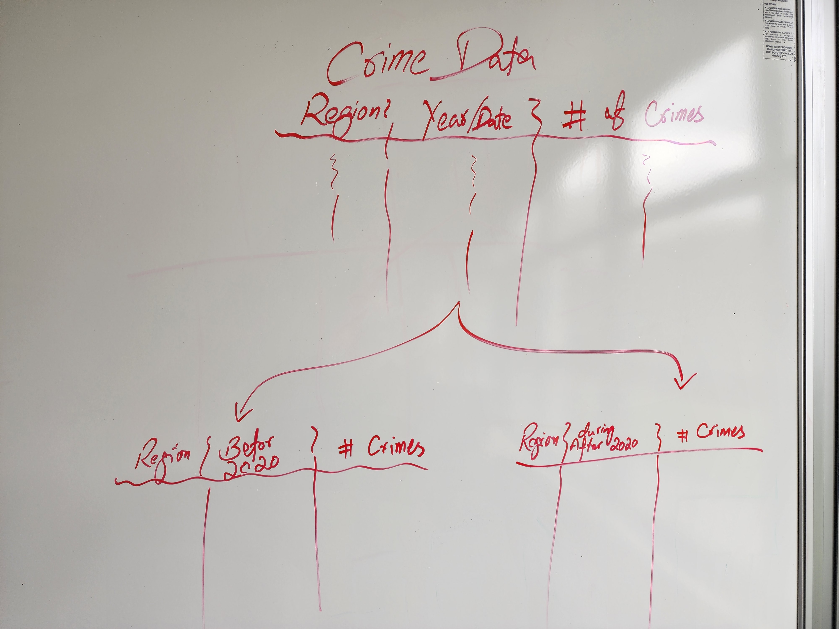
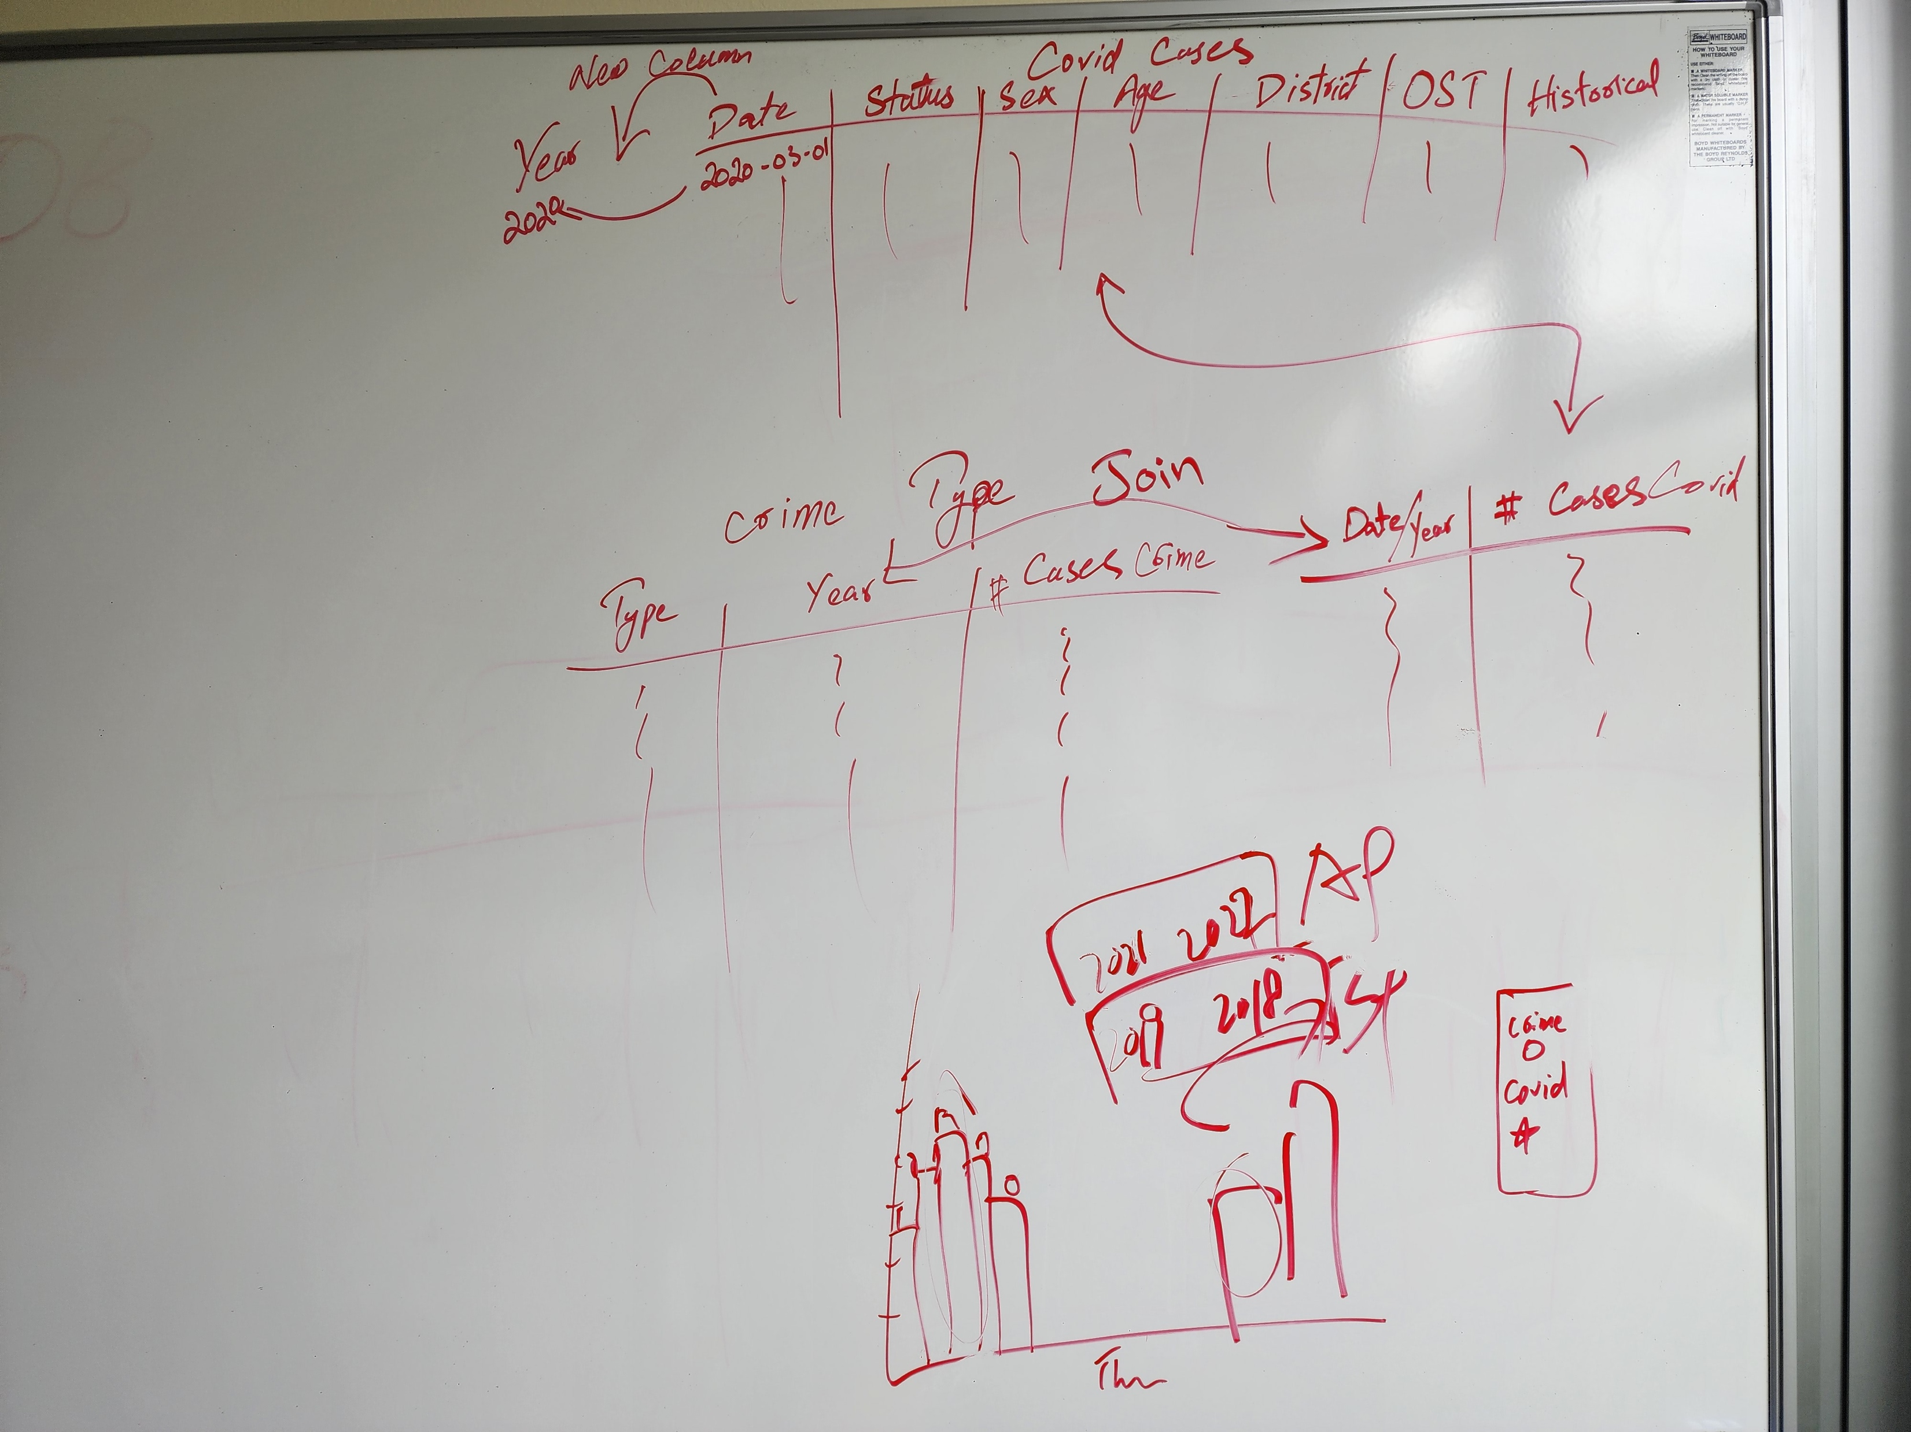
Planning
Notes:
The Major challenge we faced was to collect the CORRECT data.
there is a lot of data available on COVID but not much on how it affected different sectors.
So, the data was collected from different resources.
Now we got the data but there was even bigger problem, that our data had no common ground to join the datasets on.
Covid data had number of cases on daily bases, vaccination data was in date-range (weekly or so).
Crime data was yearly and was divided into different regions, but once again the region boundary for DHB and Police Districts are different which means most of the Districts didn’t align between Dataset.

Slide 6
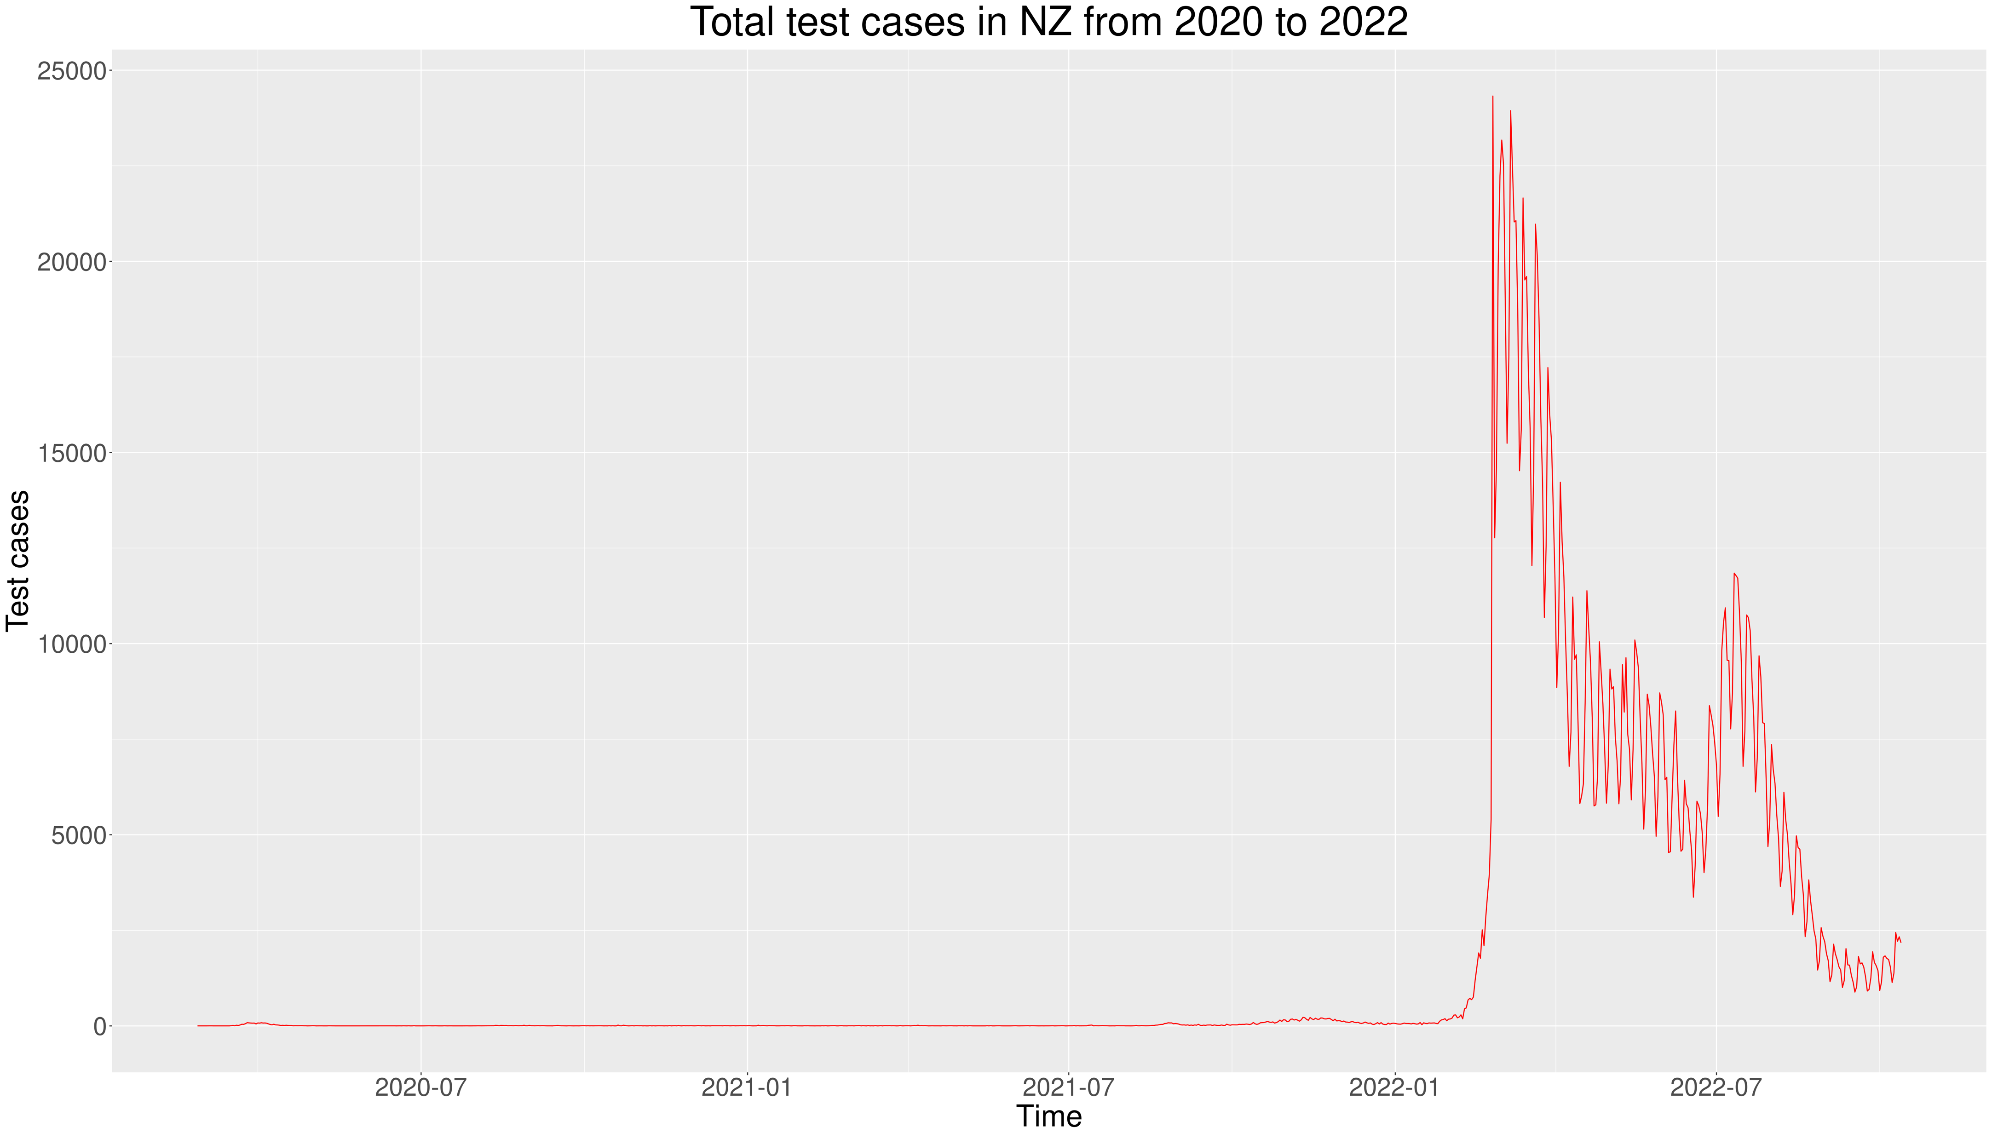
Covid Cases
Zahid Khan
Notes:
The graph on screen shows the Trend line for Covid Cases till August 2022, As you can see that in the beginning when NZ Govt. was enforcing Lock-downs the number of cases were very low or well controlled, but in 2022 when Govt. decide to not enforce the traffic light system anymore the number of cases increased dramatically.

Slide 7
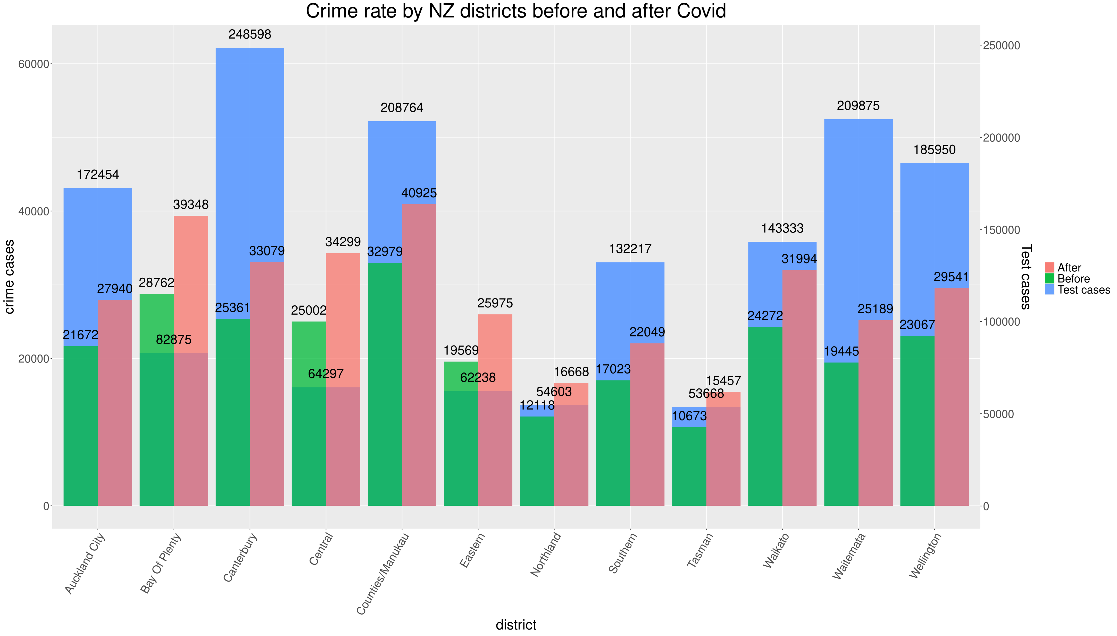
Crime Rate
Zahid Khan
Notes:
Now the biggest question we wanted to answer was that what are the effects of COVID on crime rate in New Zealand. Did the crime rate decrease due to all the lockdowns and restriction?
Well, to answer that we wrangled the dataset for crime-rate in NZ for before and during the covid and combined it with the number of cases per region which once again was a big task to align the regions of each dataset.
Now this graph shows to total number of COVID cases per region in blue,
Crime rate before COVID is in green, and the period of data is 2 years before COVID.
AND
Crime rate during COVID is in RED.
As we can see clearly that CRIME-Rate during COVID increased in every region of the country.
We do not think there is a direct relation between number of case and crime rate per region, COVID influenced every region even the one with lower number of covid cases in the country.

Slide 8
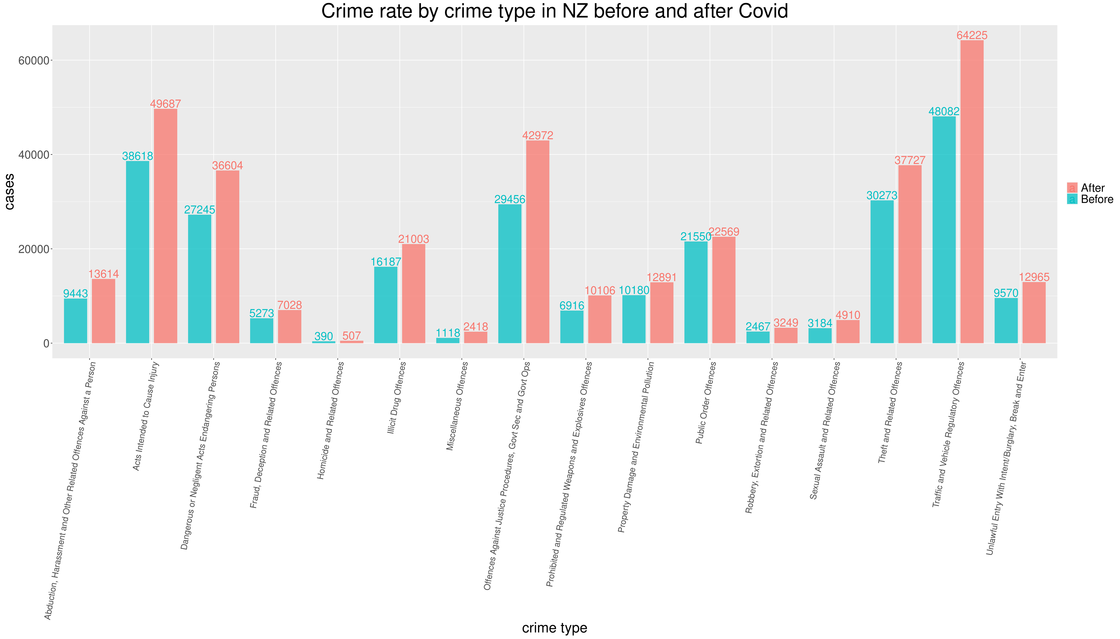
Crime Rate
Zahid Khan
Notes:
Now we know that the COVID had a significant effect on Crime-Rate in New Zealand. So, we decided to dig a little deeper and what types of crimes are on rise.
As we can see from the graph, that there are 3 – 4 types of crimes that has seen a significant increases:
Acts Intended to Cause Injury
Endangering Person
Illicit Drugs
Offences Against Justice Procedures
Theft
Traffic Offences
I believe COVID has played a big role in all of this,
I think there are other factors that played here as well, like Australia sending back criminals that has started a Power War between gangs.

Slide 9
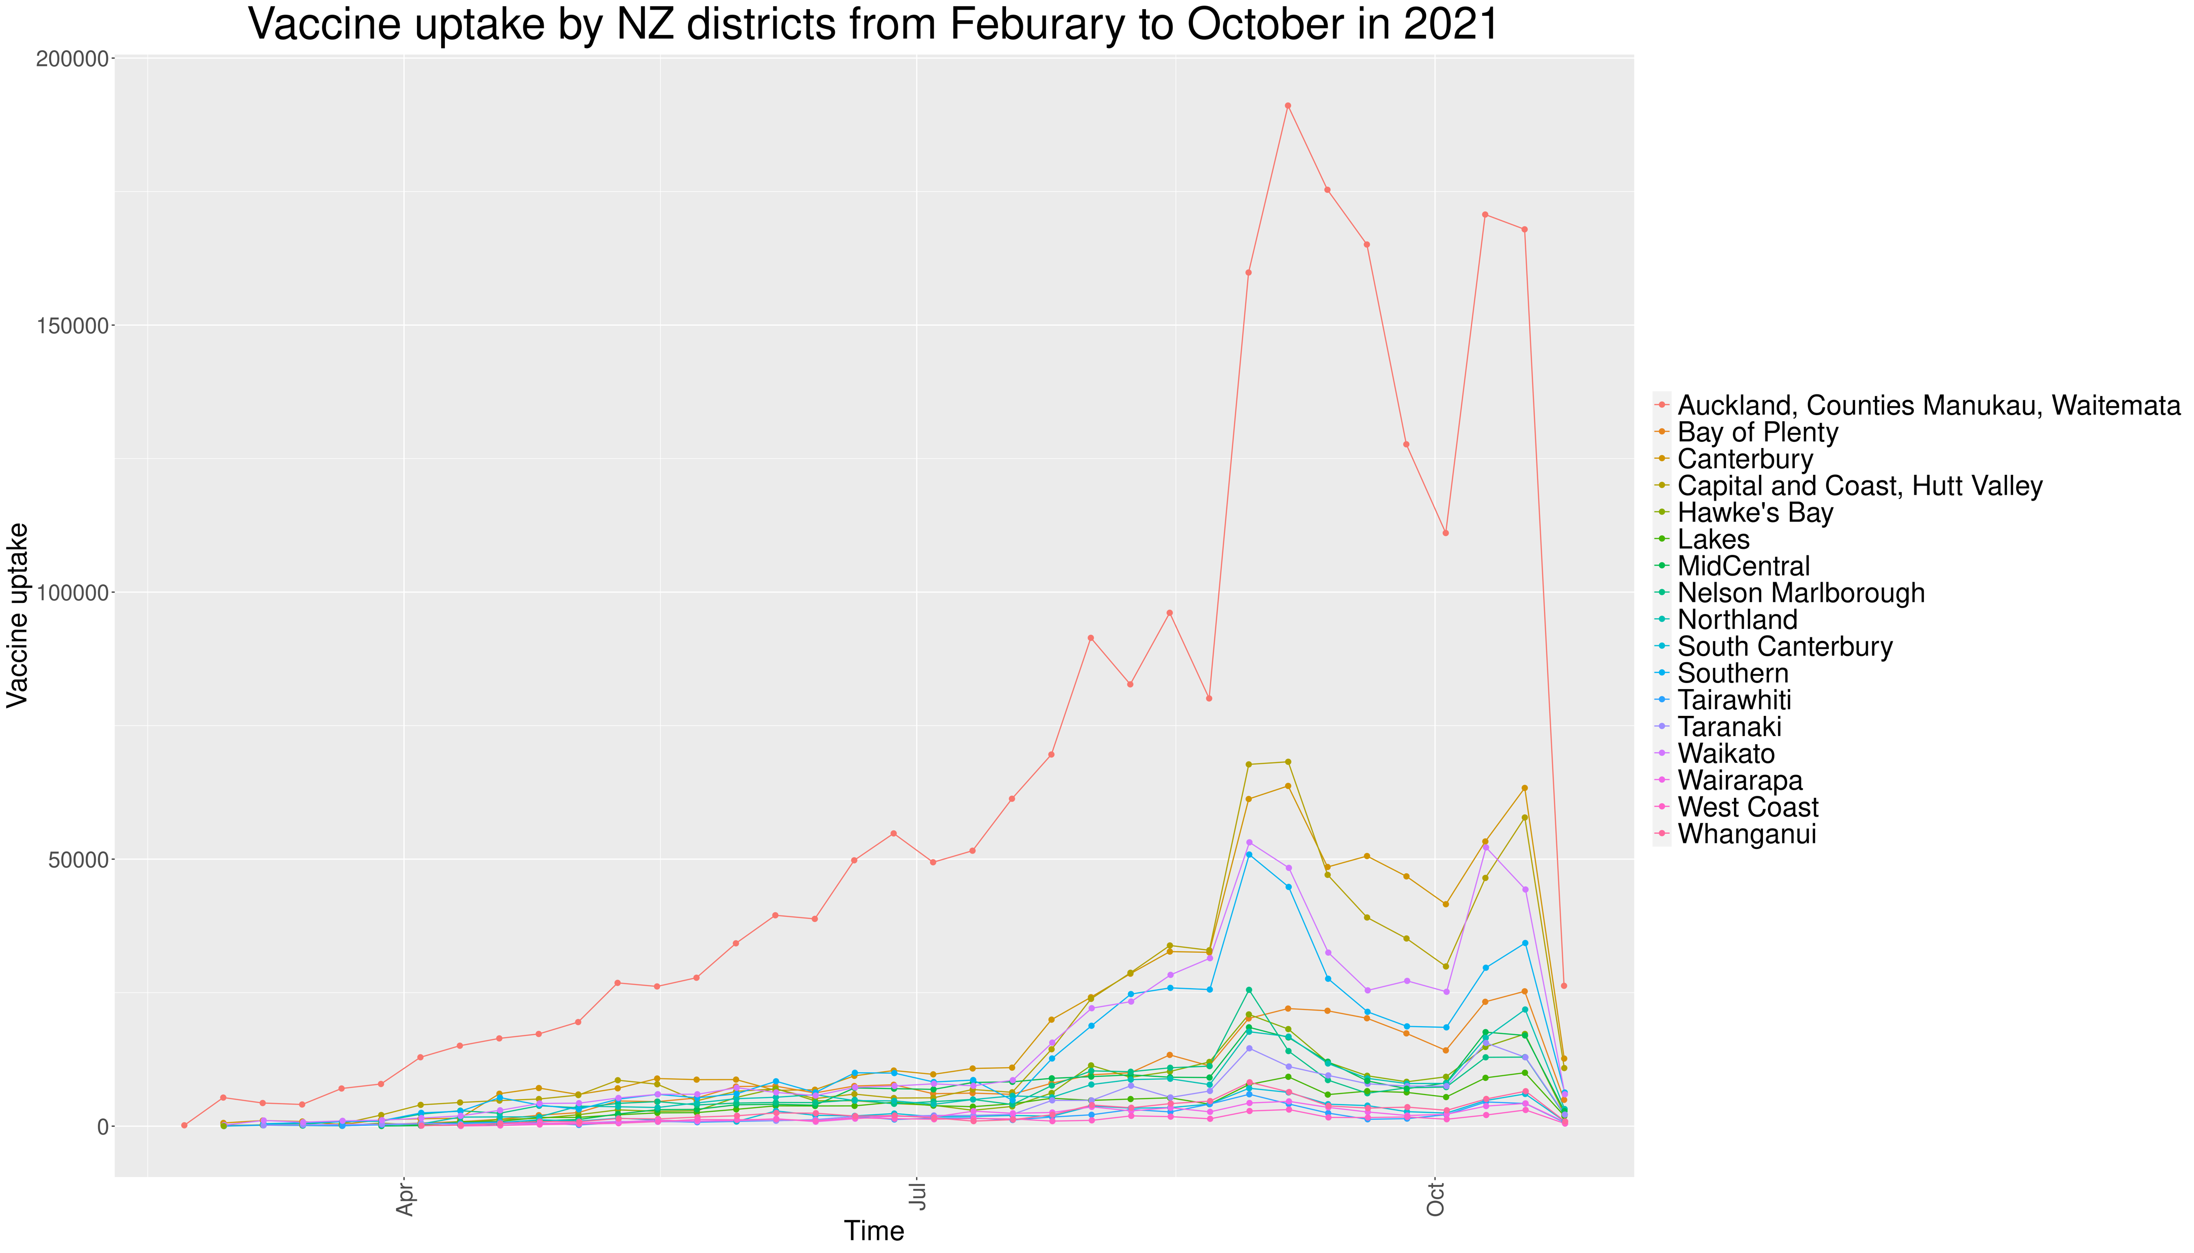
Vaccine Rate
Kaishun (Ted) Yang
Notes:
Vaccine, as one of the most essential factor that directly alleviate covid impact, we would like to find out how effective it has been to New Zealand communities.
Ever since Covid-19 vaccines have been available at 2021 February 14th, NZ ministry of health has collected administered vaccine uptake by districts till October.
We gathered and reproduced the data into the graph above that shows the total number of vaccine uptake by regions. In this graph, it shows Auckland has an exceptionally high vaccine uptake number from beginning to the end, and the rate for the rest of region does have risen up between July and October but they have very subtle difference before that. What is the reason of that? The answer is in the next graph.

Slide 10
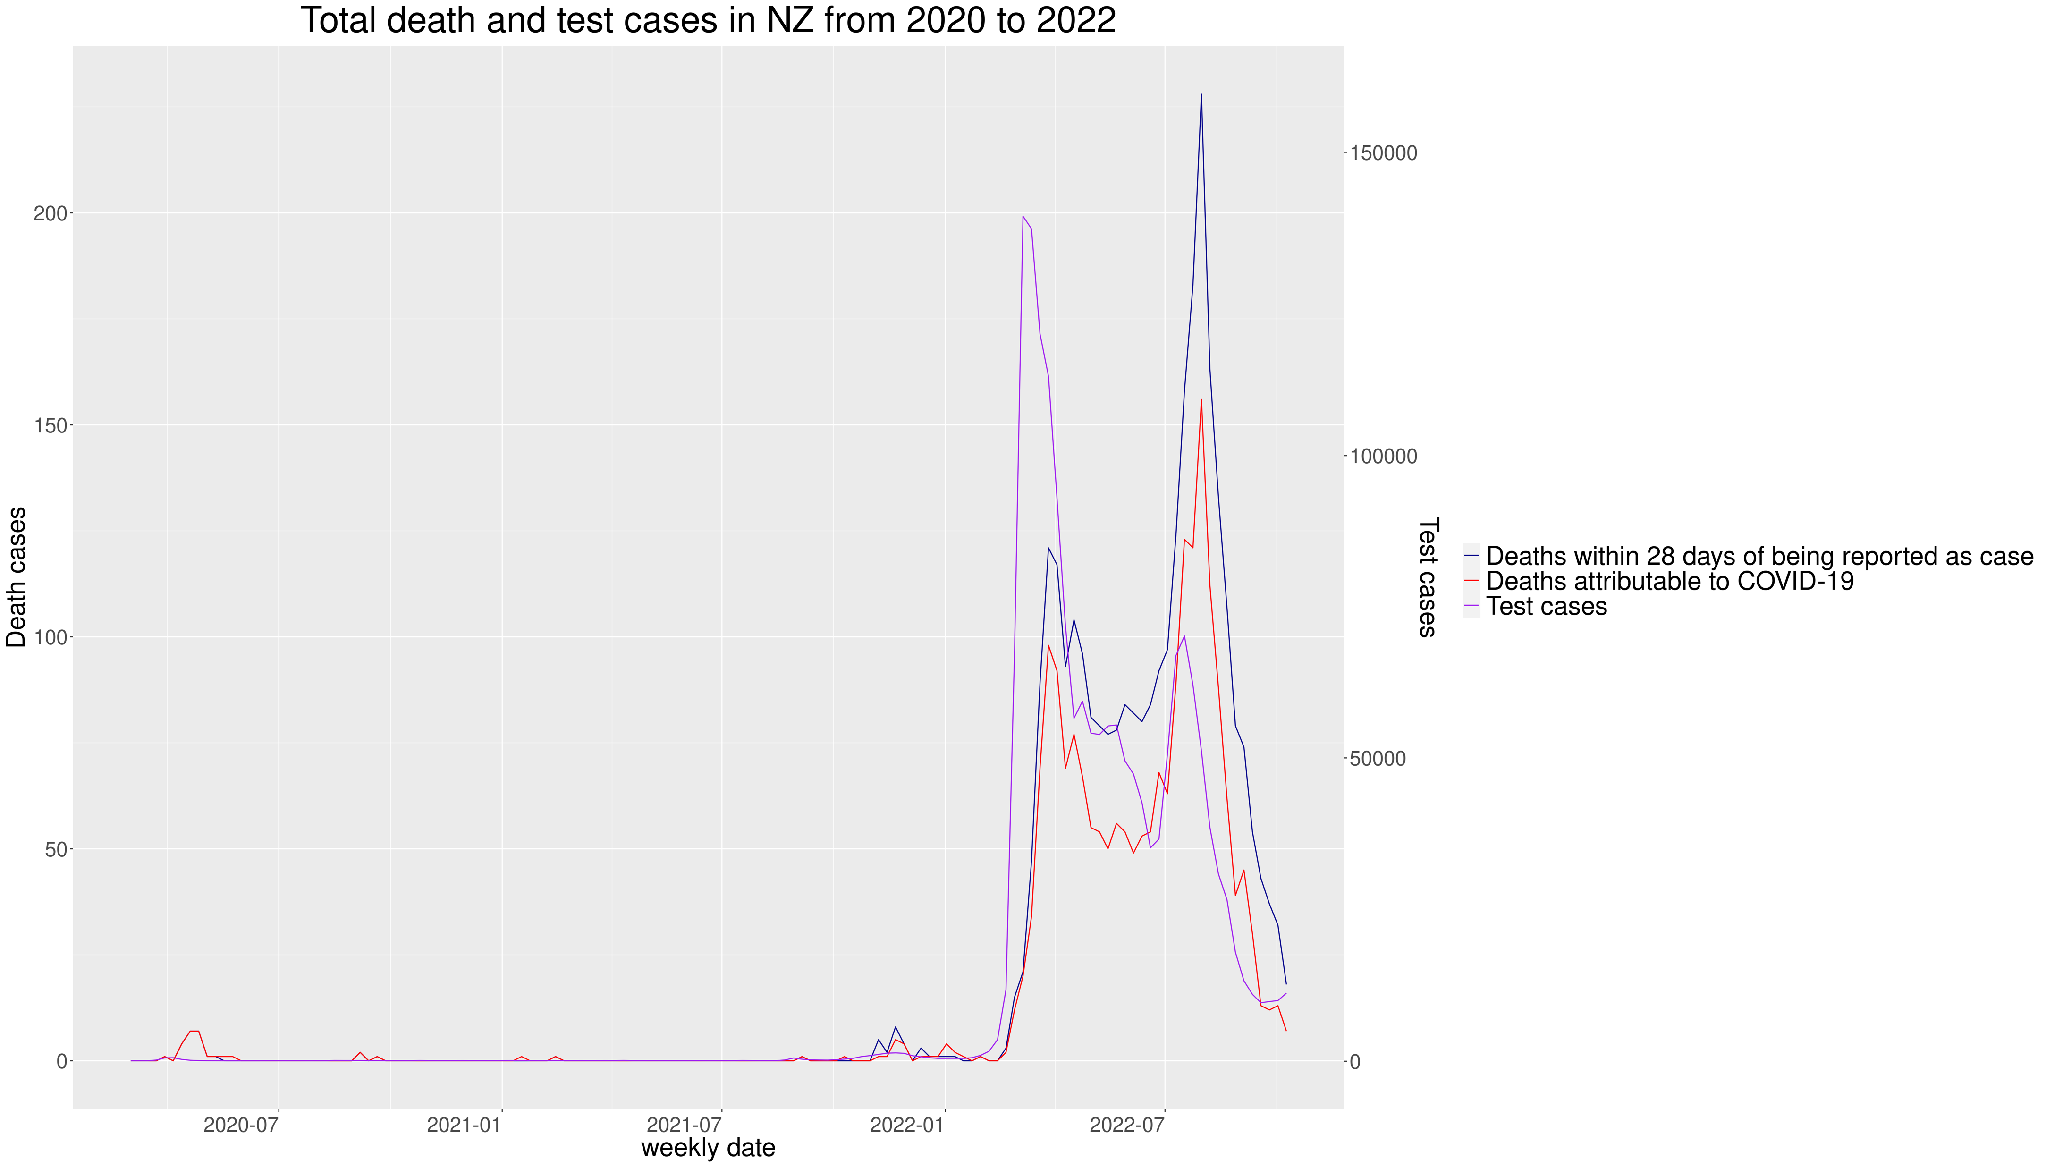
Death Rate
Kaishun (Ted) Yang
Notes:
In this graph, it shows the total Covid test cases and death cases after the covid. The dark blue line shows the death rate that follows the scale on the left and purple line manifest the test cases on the right. In conclusion, we can tell either Covid cases and death cases are not evidently high in 2021 vaccine uptake period until the end of 2021 both rate slightly increased and then dramatically rised in 2022. That change shows the vaccine is effective enough to prevent large infection and death especially at the beginning phase. Now let us combine two graph to see what happen in 2021 vaccine period.

Slide 11
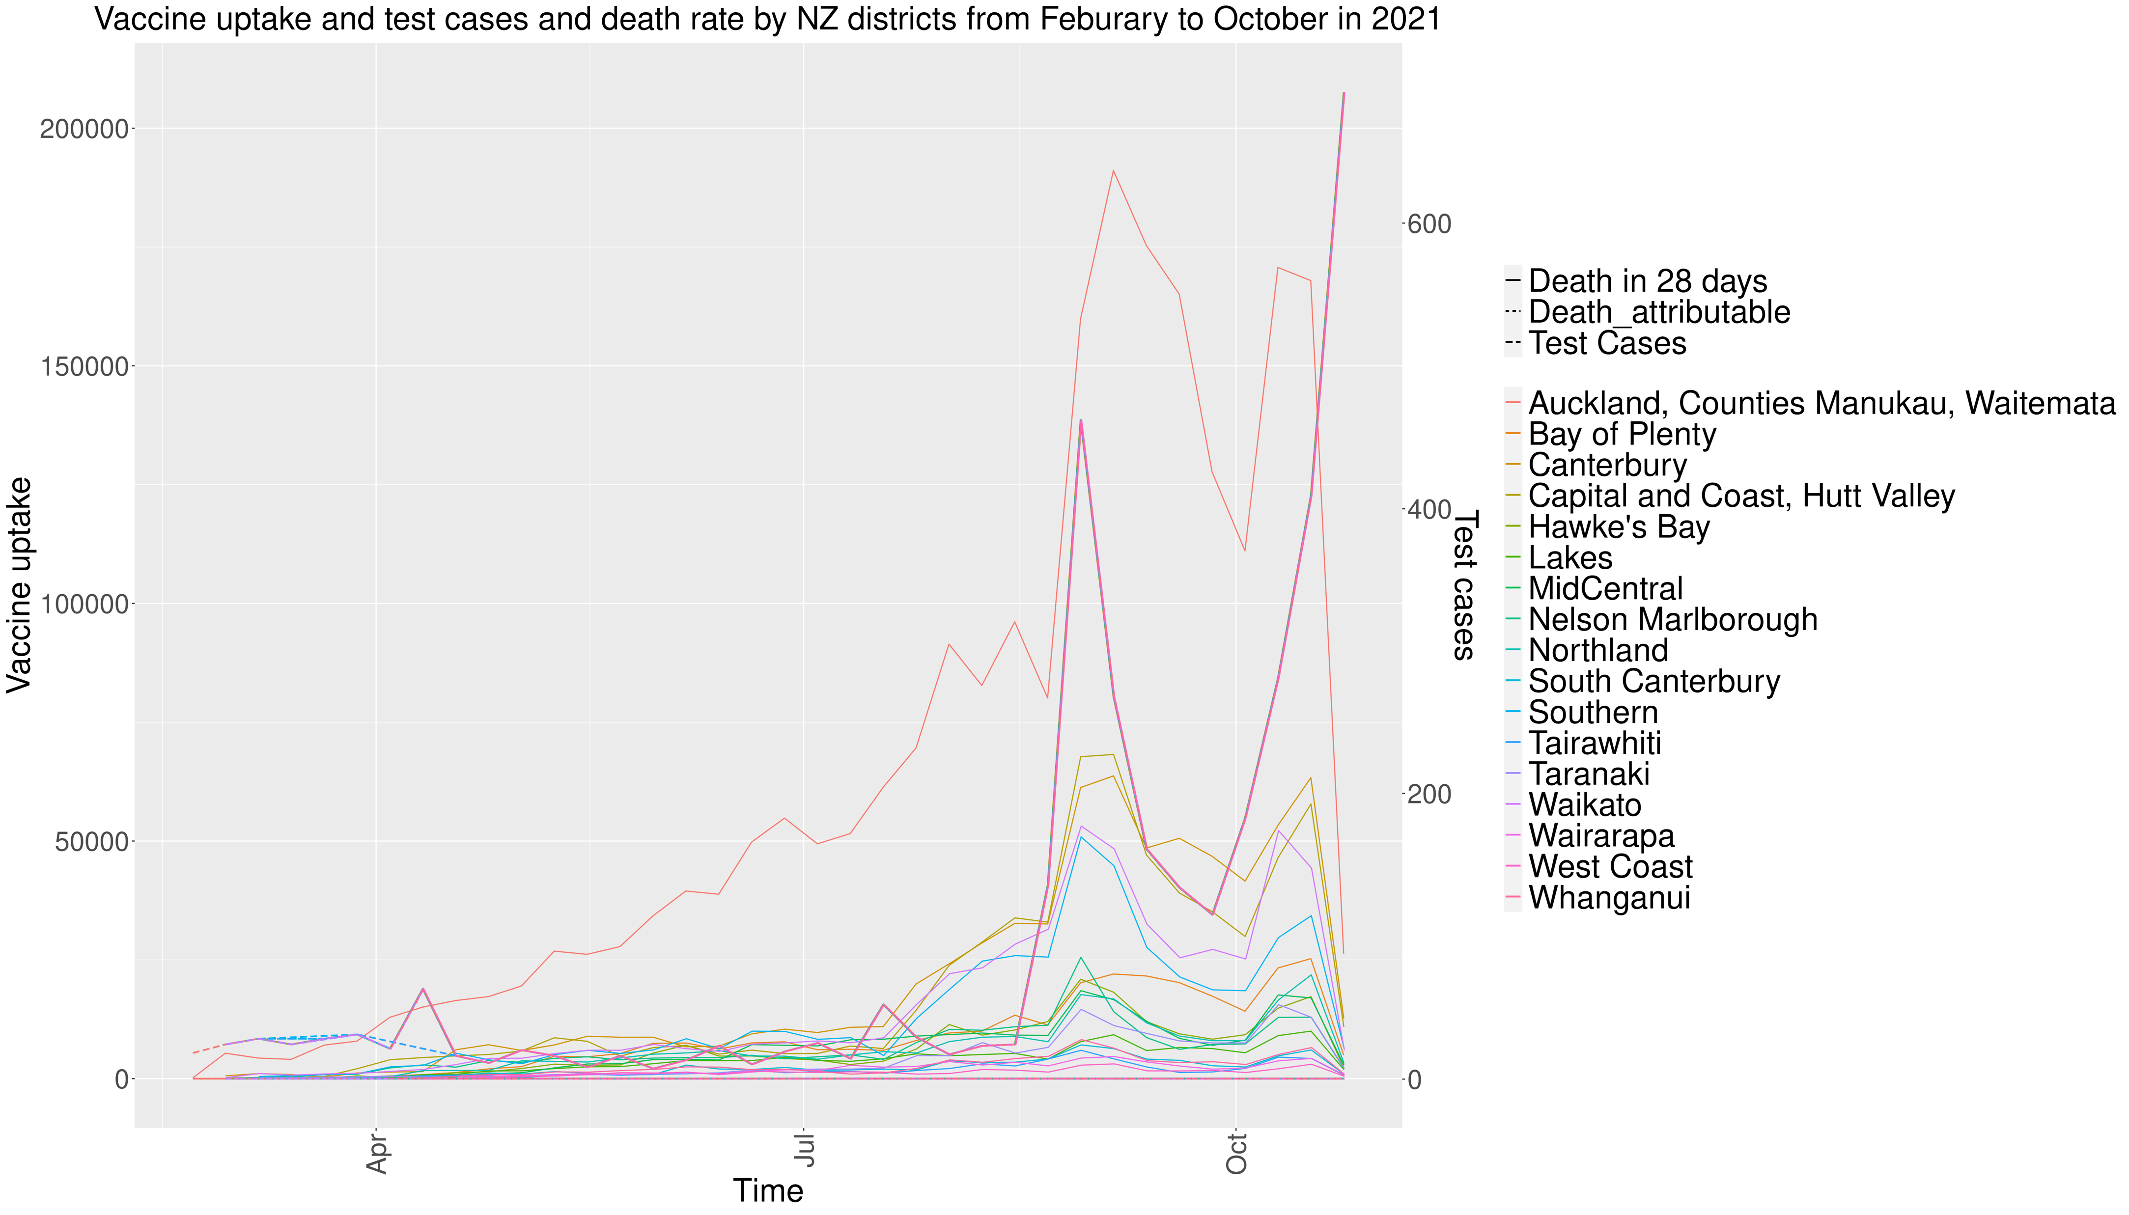
Death Rate
Kaishun (Ted) Yang
Notes:
In this graph, the dark red line shows the test cases and dotted line shows the death cases. As we can tell that the death cases are extremely close to 0 at the very bottom of graph, and total test cases has two jumps around September and October. That implies that the vaccine rate has weak relation to test cases or test cases stimulate people to take vaccine. Yet it does have a strong connection to death rate that shows substantial success during the period.

Slide 12
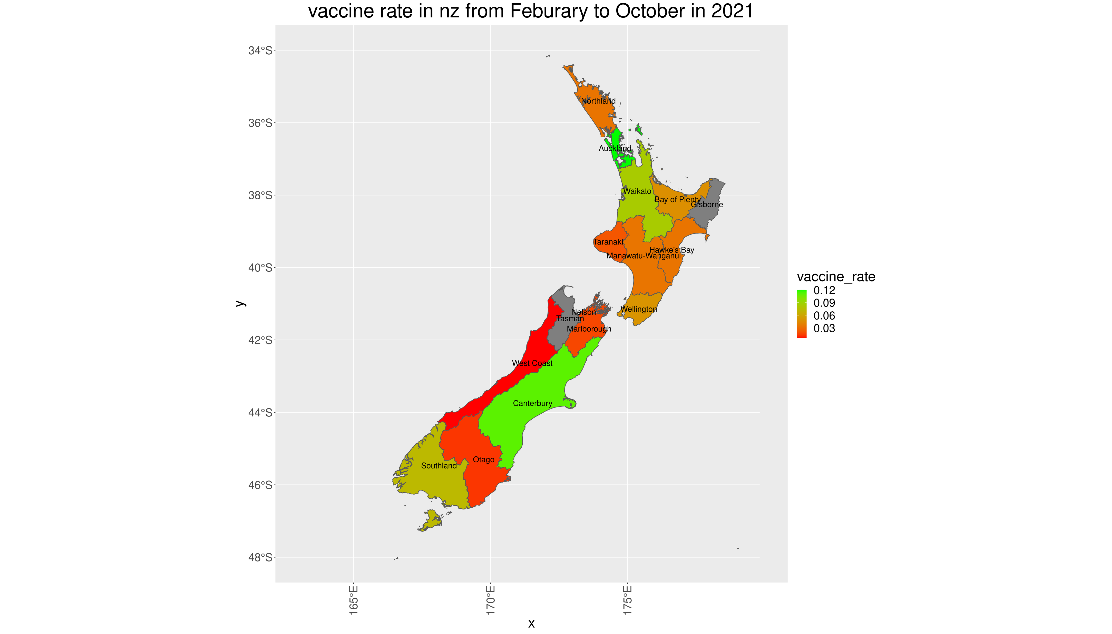
Vaccine Rate
Kaishun (Ted) Yang
Notes:
In the end, as the graph before doesn’t shows a good example how high of vaccine rate in terms of districts, We created a map plot that shows the vaccine rate in each region.

Slide 13
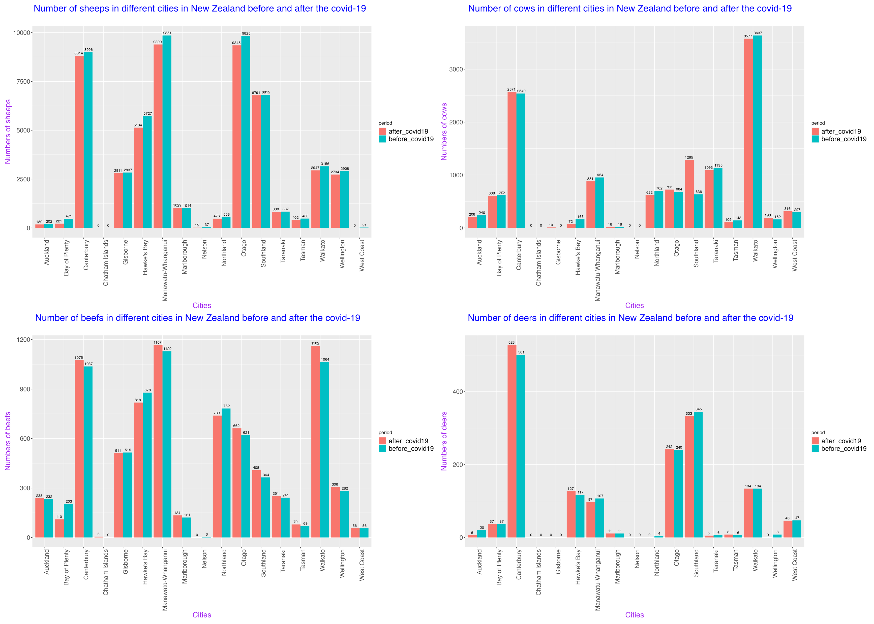
Agriculture
Jiani (Norie) Wu
Notes:
Next I will show the data on the number of livestock in New Zealand before and after the outbreak. divide into 4 spices 2018-2021
There are 13 cities all together and blue colored column is the number before coviv_19 and the pink one is the data after outbreak.
1.From the sheep comparison graph, every cities in NZ had a slight reduction about numbered of sheep after covid,
2.From the cow‘s comparison graph，there were 8 cities experienced a decreasing in number of cows after covid
3.From the beef comparison graph , the quantities of beefs kept raising in 80 percent of cities in NZ , so there was a little influence on the number of beef cattle in NZ after outbreak
4. Only 5 cities were influenced into a reducing trends
In conclusion, from data graphs , this is a small bad impact on the number of the livestock before and after covid-19 , only sheep quantities got little bit reduction on every city，Other species were not affected by the decline in numbers

Slide 14
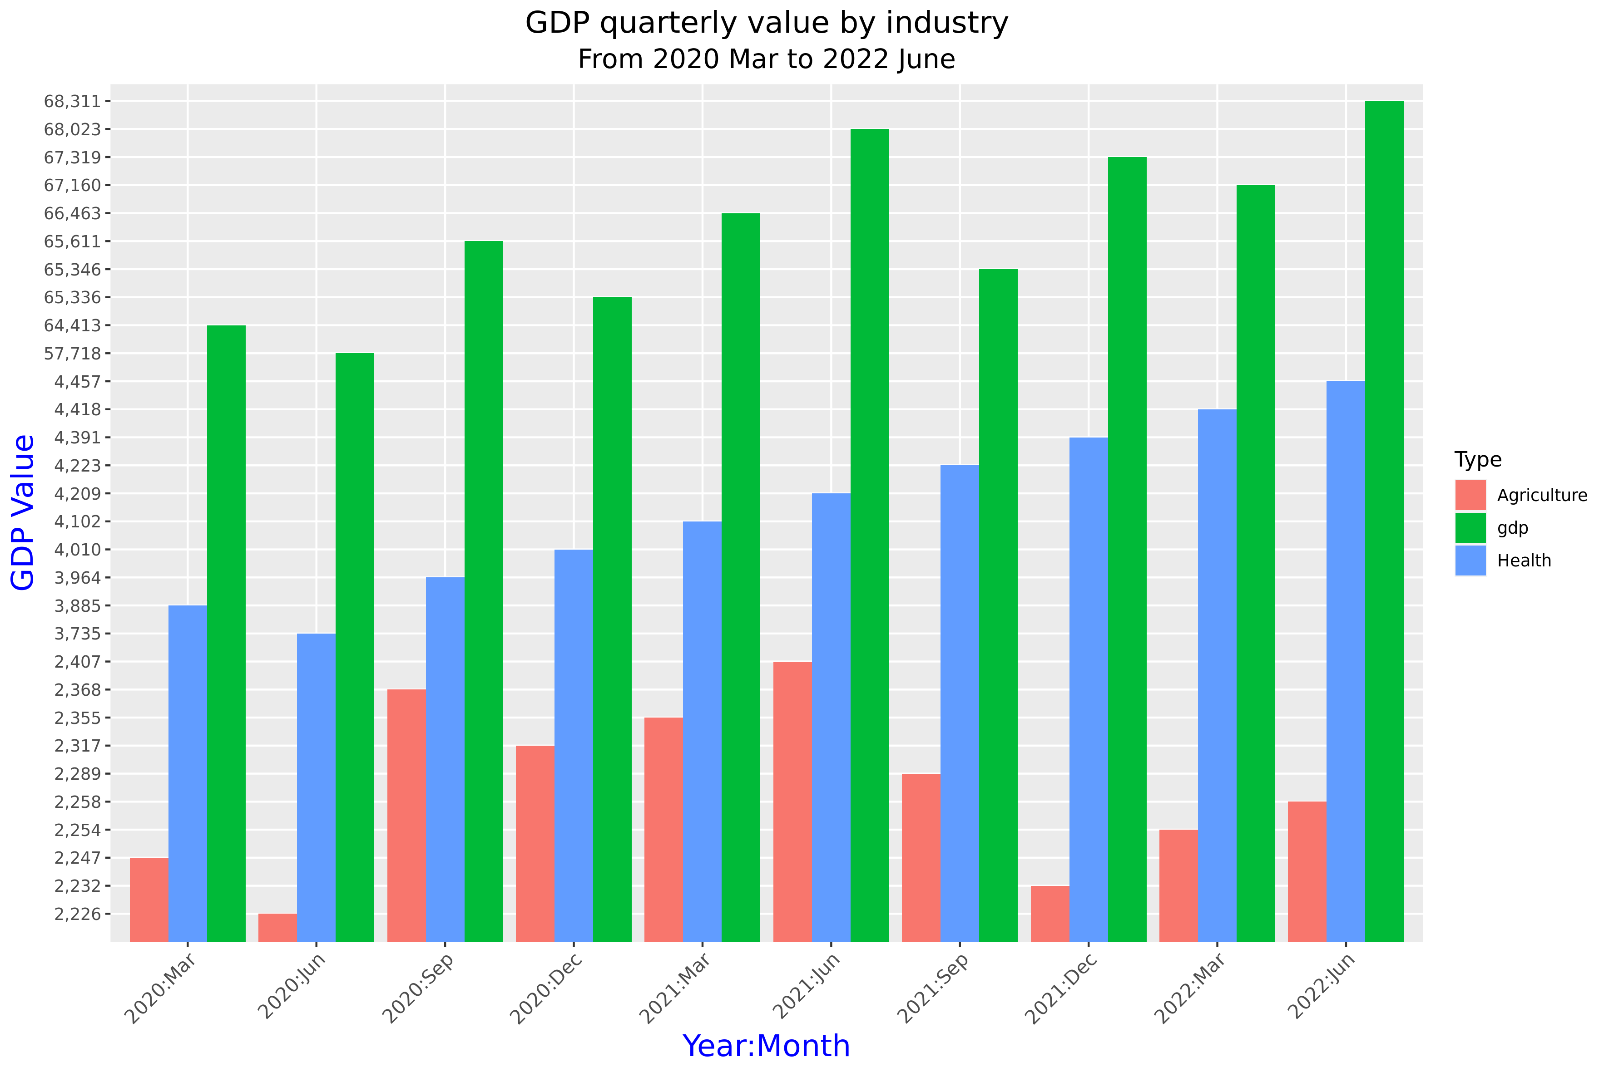
GDP
Pei (Perry) Li
Notes:
I used table for quarterly changes in GDP, from January 1987 to June 2022. In order to observe the impact of covid-19 on GDP, I intercepted data from March 2020 to June 2022.
As my teammates analysed the impact of covid-19 on agriculture and healthcare, I also compared GDP changes in these industry.
As we can see in the graph, health GDP shows a continuous upward trend. Agricultural GDP saw a huge reduction in the first few months of covid-19, which coincided with the start of New Zealand's lockdown After the end of the lockdown in September 2020, agricultural GDP started to grow up until the lockdown started again in August 2021.

Slide 15
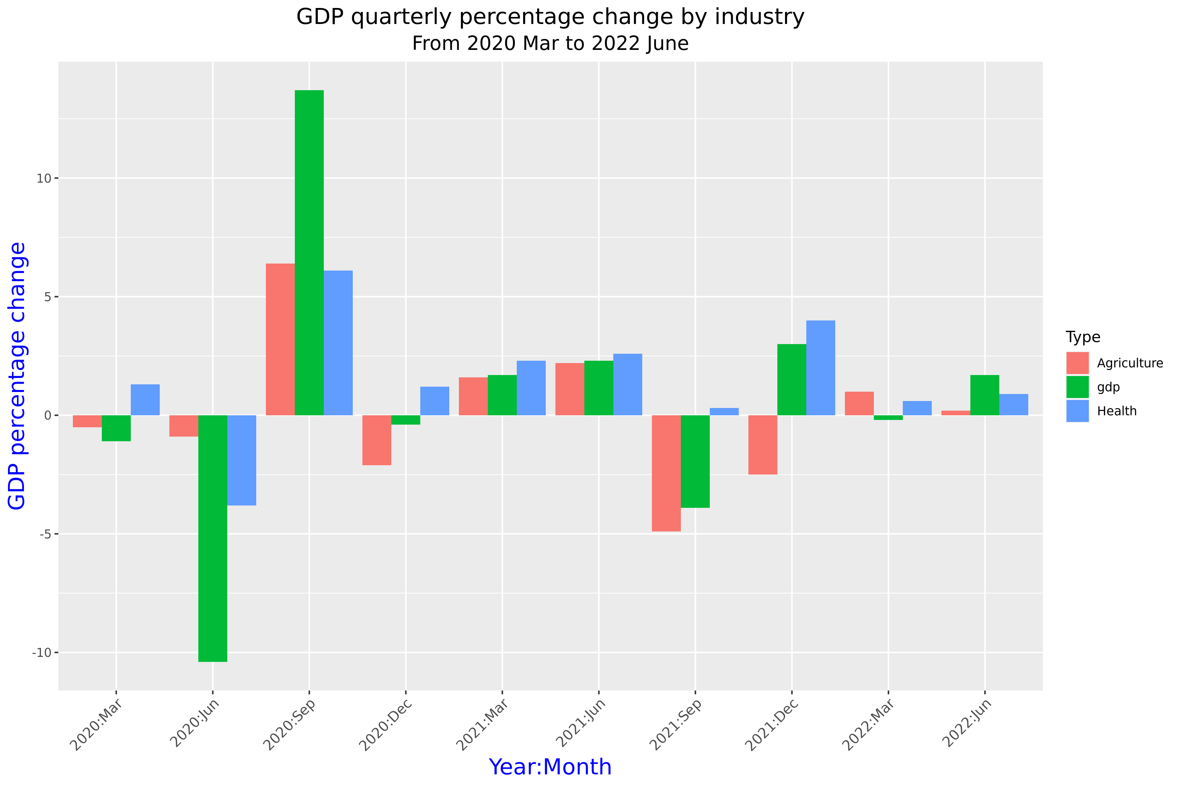
GDP
Pei (Perry) Li
Notes:
The second graph shows the quarterly percentage change in GDP. As we can see in the graph, from March to July 2020, GDP decreased significantly. During this time, the virus was raging all over the world, and New Zealand went into lockdown.
In September 2020, after the lockdown ended, there was a significant increase in GDP.
In September 2021, the number of covid-19 cases were rising again, and New Zealand went into a second lockdown. Both total and agricultural GDP declining, until in December 2021. Except of health GDP, which stayed positive through out the pendamic.

Slide 16
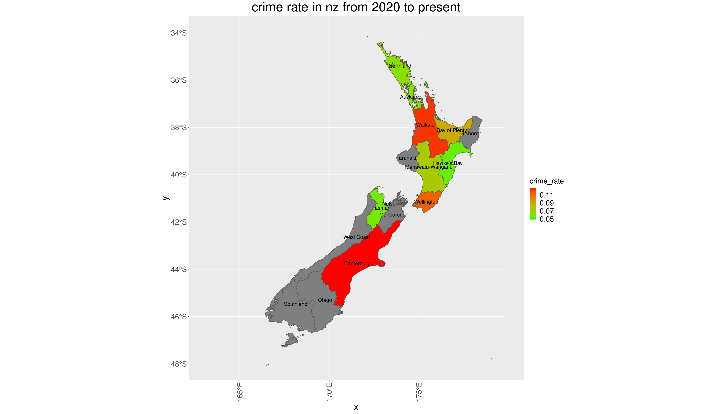
Extra
Notes:
This is an extra map showing the crime rate in New Zealand, The region boundary from GGPLOT and NZ Police statistics was very different, hence the data for some of the regions didn’t align properly.

Slide 17
Conclusion
Covid has hugely influenced every sector in New Zealand
Crime Rate has gone up
NZ Economy has suffered
NZ Health has suffered
Very little growth in Agriculture
Notes:
As we expected, COVID had a huge influence on almost every sector.
We are experiencing an increase in Crime-Rate, Economy is suffering, and health sector has suffered hugely.

Slide 18
Q&A
Add New Zealand Map Here…

Slide 19
Thank You
Honourable Mentions:
Teaching Team
Tutoring Team
Classmates
Thank you for your help, support and exchange of ideas through out the course.

